Slide 1
The Politics of Health and Health Care-Group Project
Krystal, melanie, Sonia, Amanda, t.k. & Rosa
hsn/476
Malinda Sever
March 18, 2019
Notes:
Melanie: Anything before 1940s
Rosa: 1940-1960
T.K.: 1960-1980
Amanda: 1980-2000
Sonia: 2000-present
Krystal: Intro/Conclusion and final review and submission of assignment

Slide 2

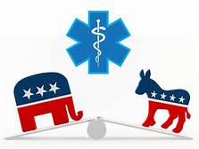
Objectives:
To understand the progression of health care reform
Explain the political climate in each major reform era
To learn the recurring trends in health care reform
Notes:
Krystal

Slide 3
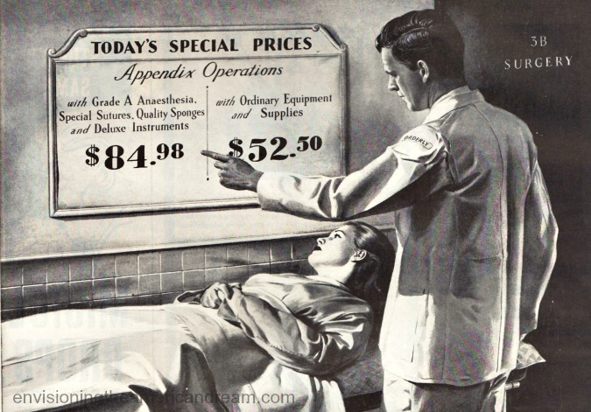
Health Care in the Early 1900’s
26th President of the United States, Theodore Roosevelt believed that the people of the country need to be strong to have a strong country
AMA grows to 62,000 physicians
Working class not in support of compulsory medicine
Notes:
My name is Melanie and I will be presenting health care before the 1940’s. This was a time of war and health care was an important topic but organized health care was not in the works. The 26th president of the United States, Theodore Roosevelt believed in health insurance, but he didn’t have an initiative to lead the way. The American Medial Association (AMA) grew to 62,000 physicians in this decade and they were in support of organized healthcare, yet the working class was not in support of compulsory medicine.

Slide 4

The 1910’s and 1920’s
WWI- War Risk Insurance Act
  Covered service men
Post WWI changes-doctors and hospitals charged more than the average person could afford
The precursor to Blue Cross
Notes:
During the first World War, the congress passed the War Risk Insurance Act covering service men in case of injury or death. There were thoughts about expanding this, but it essentially ended with the war in 1918. The benefits of the soldiers were still paid to their dependent's though. After the war, the cost of health care changed as doctors and hospitals started to charge more than the average person could afford. There was a group of teachers that were concerned about this, so they began to prepay for medical expenses (usually about 21 days prior) through Baylor University Hospital. This became the precursor to Blue Cross.

Slide 5
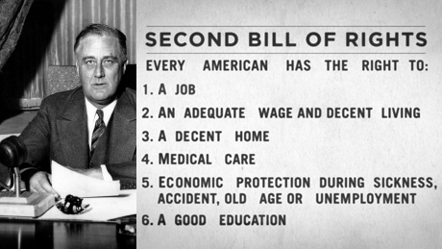
The 1930’s
The Great Depression (1929-1939)
Franklin D. Roosevelt (32nd President of the United States, 1933-1945)
Social Security Act of 1935
Notes:
Once the Great Depression hit, it caused a lot of attention to be paid to health care reform. The Blues (Blue Cross) was expanding its way across the country. Franklin D Roosevelt, the 32nd President of the United States took the issue of health care very seriously. He worked on a health care bill that included “old age” benefits. The American Medical Association greatly opposed a national health system. The president decided to drop the insurance part of the bll and the Social Security Act of 1935 was born.

Slide 6
Notes:
rosa

Slide 7
Notes:
rosa

Slide 8
Health Care reform:
1960-1980
Understanding the history of health care reform allows people an understanding of issues related to health care and government involvement.
1960-1965
1970-1980
1965-1970
Notes:
Understanding the history of health care reform allows people an understanding of issues related to health care and government involvement. Rambur describes health care reform as the strategies to address unintended consequences of previous health care policies and accidents throughout history (2015).
1960-1965
During this time, hospital care had doubled and was steadily increasing. People were retiring ad left without health care coverage.
The government started to keep tallies on the National Health Expenditures (NHE) and calculated them as a percentage of Gross Domestic Product (GDP). During this time, the NHE accounted for 5% of the GDP.
During the 1961-1963 the democratic John F. Kennedy was in office. He could see that NHE was on the rise because more people were retiring from their jobs and would be without health care coverage, which could be costly for the US. Therefore foreseeing this he tried to urge Americans to support the King-Anderson Bill, which would be a part of the Social Security Act to provide limited health care coverage to those 65 years and older (Jacobs and Skocpol, 2015). This bill was opposed by the American Medical Association (AMA) but was the foundation of what is known today as Medicare.
1963
After the assignation of President Kennedy, Lyndon Johnson ( a part of the democratic party) picked up where Kennedy left off. He signs Social Security Act of 1965 (later would be known as Medicare and Medicaid). This made sure that the elderly, poor, and disabled citizens had access to affordable healthcare through physicians, hospitals, nursing homes, etc.
1965-1970
1970’s
In the seventies health care was more affordable but many Americans still did not have basic health care. The NHE now accounted for 6.9 % of the GDP, due to unexpected high medical expenditures, economy inflation, increase of hospital expenses as well as profits, increase use of technology, medication and conservative treatments (Jacobs and Skocpol, 2015).
1970-1980
1971
Republican President Nixon had his own ideas on healthcare and proposed the National Health insurance Standard Act (NHISA). The NHISA proposed a government-prescribed minimal level of insurance coverage mandated to be provided by employers and financed by payments of premiums from employers and employees (Manchikanti et al., 2017).Nixon had good intentions on wanting a most Americans to have some sort of health insurance from their employer and have Medicare once they retired. Due to the Watergate scandal, many decided to distance themselves from Nixon and the law did not pass but laid the groundwork for health care reform used today. Nixon was able to gain the passage of the Health Maintenance Organization Act of 1973 ( previously known as the prepaid health care plan) did set into motion the ground work needed for managed care. At this time, American medicine was seen as in crisis due to the economic recession and increased inflation during this time.
During the Ford Administration (1974-1977), the National Health Planning and Resources Development Act (HPRDA) of 1974 was put into place. The purpose of the HPRDA was to reduce and avoid the unnecessary duplication of health care facilities and services, by mandating the certificate of need (COM) programs in the states (Jacobs and Skocpol, 2015). The HPRDA was reapealed in 1986, but 36 states continue to utilize the COM programs today. Proposals by Ted Kennedy and President Richard Nixon that promoted variations of universal health care and presidential candidate Jimmy Carter also proposed universal health care (Manchikanti et al., 2017).
In 1977 democrat president, Carter proposes that Medicaid expansion (Children’s Health Assessment Program) for poor children under age 6, but it did not pass to a vote in congress.

Slide 9
HEALTH CARE REFORM:
1960-1980
What is consistent?
What has changed?
Why are people so passionate about Health Care?
1960-1970
1970-1980
NOW
Notes:
Understanding the history of health care reform allows people an understanding of issues related to health care and government involvement. Rambur describes health care reform as the strategies to address unintended consequences of previous health care policies and accidents throughout history (2015).
1960-1965
During this time, hospital care had doubled and was steadily increasing. People were retiring ad left without health care coverage.
The government started to keep tallies on the National Health Expenditures (NHE) and calculated them as a percentage of Gross Domestic Product (GDP). During this time, the NHE accounted for 5% of the GDP.
During the 1961-1963 the democratic John F. Kennedy was in office. He could see that NHE was on the rise because more people were retiring from their jobs and would be without health care coverage, which could be costly for the US. Therefore foreseeing this he tried to urge Americans to support the King-Anderson Bill, which would be a part of the Social Security Act to provide limited health care coverage to those 65 years and older (Jacobs and Skocpol, 2015). This bill was opposed by the American Medical Association (AMA) but was the foundation of what is known today as Medicare.
1963
After the assignation of President Kennedy, Lyndon Johnson ( a part of the democratic party) picked up where Kennedy left off. He signs Social Security Act of 1965 (later would be known as Medicare and Medicaid). This made sure that the elderly, poor, and disabled citizens had access to affordable healthcare through physicians, hospitals, nursing homes, etc.
1965-1970
1970’s
In the seventies health care was more affordable but many Americans still did not have basic health care. The NHE now accounted for 6.9 % of the GDP, due to unexpected high medical expenditures, economy inflation, increase of hospital expenses as well as profits, increase use of technology, medication and conservative treatments (Jacobs and Skocpol, 2015).
1970-1980
1971
Republican President Nixon had his own ideas on healthcare and proposed the National Health insurance Standard Act (NHISA). The NHISA proposed a government-prescribed minimal level of insurance coverage mandated to be provided by employers and financed by payments of premiums from employers and employees (Manchikanti et al., 2017).Nixon had good intentions on wanting a most Americans to have some sort of health insurance from their employer and have Medicare once they retired. Due to the Watergate scandal, many decided to distance themselves from Nixon and the law did not pass but laid the groundwork for health care reform used today. Nixon was able to gain the passage of the Health Maintenance Organization Act of 1973 ( previously known as the prepaid health care plan) did set into motion the ground work needed for managed care. At this time, American medicine was seen as in crisis due to the economic recession and increased inflation during this time.
During the Ford Administration (1974-1977), the National Health Planning and Resources Development Act (HPRDA) of 1974 was put into place. The purpose of the HPRDA was to reduce and avoid the unnecessary duplication of health care facilities and services, by mandating the certificate of need (COM) programs in the states (Jacobs and Skocpol, 2015). The HPRDA was repealed in 1986, but 36 states continue to utilize the COM programs today. Proposals by Ted Kennedy and President Richard Nixon that promoted variations of universal health care and presidential candidate Jimmy Carter also proposed universal health care (Manchikanti et al., 2017).
In 1977 democrat president, Carter proposes that Medicaid expansion (Children’s Health Assessment Program) for poor children under age 6, but it did not pass to a vote in congress.

Slide 10

Add a Slide Title - 2
Notes:
amanda

Slide 11
Add a Slide Title - 4
Notes:
amanda

Slide 12
HEALTHCARE REFORM:
2000 - PRESENT
Breast and Cervical Cancer and Prevention Act of 2000. This act allows states to provide Medicaid coverage for every uninsured woman for treatment of breast or cervical cancer. In case they have been diagnosed through a CDC screening program.
Deficit Reduction Act of 2005. The act makes necessary changes to Medicaid related to cost sharing, benefits, premium and asset transfers.
Notes:
My name is Sonia, am presenting the health care reforms from 2000 since the present time. In early 20000 the major disease that was dominates was breast and cervical cancer. As a result, a bill was passed to help people who suffered from the cancerous condition. The patient was involved in the screening program for testing. In 2000 technology was increasing resulting in the development and modern hospitals. The government also passed the Deficit Reduction Act of 2005 which reduces the cost of the patient. Oberlander, J. B., & Lyons, B. (2009).

Slide 13
Mental Health Parity Act of 2008. The act amended to ensure that the Insurance companies treat mental health problems including abuse disorders, on an equal basis with physical disorders when health policies cover.
The American Reinvestment and Recovery Act (ARRA) of 2009. The act makes additional investments to help develop health information technology and increase primary care for treatments
Notes:
In 2008 another act was passed called Mental Health Parity Act of 2008. The government ensures that the insurance company takes all the risk of the insured patient. The insurances company was to treat all mental health problems that the patient diagnoses with according to health policy cover. In 2009 The American Reinvestment and Recovery Act (ARRA) of 2009 was formed due to the proper political atmosphere in the country health information technology increase. It results in the development of better health care. Szmukler, G., & Holloway, F. (2000).

Slide 14

Patient Protection and Affordable Care Act of March 21, 2010. The senate bill that is passed by the house of Representatives ensures that patients participate in voting.
Notes:
According to Larson, K., at al (2016). Patient Protection and Affordable Care Act of March 21, 2010, is among the current act that was passed by the Senate. Due to the stable political atmosphere, the Senate managed to passes the law that ensures that the patients are involved in voting. The law requires the patient to be considered in the voting system for maximum voting.

Slide 15


Szmukler, G., & Holloway, F. (2000). Reform of the Mental Health Act: health or safety?. The British Journal of Psychiatry, 177(3), 196-200.
Oberlander, J. B., & Lyons, B. (2009). Beyond Incrementalism? SCHIP and the politics of health reform. Health Affairs, 28(3), w399-w410.
Larson, K., Cull, W. L., Racine, A. D., & Olson, L. M. (2016). Trends in access to health care services for US children: 2000–2014. Pediatrics, 138(6), e20162176.
Notes:
Krystal

Slide 16
References
Baitman, F., & Karpay, K. (2017). Innovation. Retrieved from Harvard Business Review: www.hbr.org
Health & Pharmaceuticals. (2019). Retrieved from Statista: https://www.statista.com/statistics/184968/us-health-
expenditure-as-percent-of-gdp-since-1960/
Jacobs, L., & Skocpol, T. (2015). Health care reform and American politics: What everyone needs to know.
Oxford University Press.
Manchikanti, L., Helm Ii, S., Benyamin, R. M., & Hirsch, J. A. (2017). Evolution of US Health Care
Reform. Pain Physician, 20(3), 107-110. Retrieved from https://search- ebscohost.com.contentproxy.phoenix.edu/login.aspx?direct=true&db=mdc&AN=28339426&sit e=ehost-live&scope=site
Moore, K. (2008). The Future of Social Security: Principles to Guide
Reform. Uknowledge:Law Faculty Publications, (41)
Moseley III, JD, MBA, G. (2009, May). The U.S. Health Care Non-System, 1908-
2008. AMA Journal of Ethics, (), .Retrieved from https://journalofethics.ama- assn.org/article/us-health-care-non-system-1908-2008/2008-05
Rambur, B. (2015). Health care finance, economics, and policy for nurses: A foundational guide (1st ed.).
New York, NY: Springer.

